Slide 1

Chapter 7
Transmission Media

Slide 2
Chapter 7: Outline
7.1 INTRODUCTION
7.2 GUIDED MEDIA
7.3 UNGUIDED MEDIA

Slide 3
Chapter 7: Outline
The first section introduces the transmission media and defines its position in the Internet model. It shows that we can classify transmission media into two broad categories: guided and unguided media.
The second section discusses guided media. The first part describes twisted-pair cables and their characteristics and applications. The second part describes coaxial cables and their characteristics and applications.
The third section discusses unguided media. The first part describes radio waves and their characteristics and applications. The second part describes microwaves and their characteristics and applications.

Slide 4

7.1 Introduction
Transmission media are actually located below the physical layer and are directly controlled by the physical layer.
We could say that transmission media belong to layer zero.

Slide 5
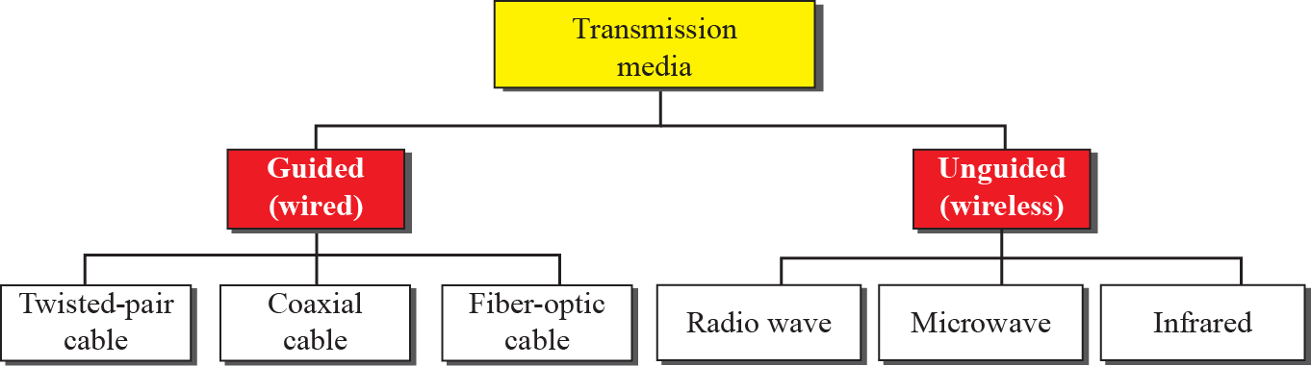
7.1 Introduction
Classes of transmission media :
  Guided Media
  Unguided Media

Slide 6
7.2 Guided Media
Guided media provide a conduit from one device to another.
  A signal traveling along any of these media is directed and contained by the physical limits of the medium.
Guided media includes twisted-pair cable, coaxial cable, and fiber-optic cable.
Topics discussed in this section:
7.2.1 Twisted-Pair Cable
7.2.2 Coaxial Cable
7.2.3 Fiber-Optic Cable

Slide 7

7.2.1 Twisted-Pair Cable
A twisted pair consists of two conductors (copper), each with its own plastic insulation, twisted together.
  One of the wires is used to carry signals to the receiver.
  The other is used only as a ground reference.
  The receiver uses the difference between the two.
The interference(noise) and crosstalk may affect both wires and create unwanted signals.

Slide 8
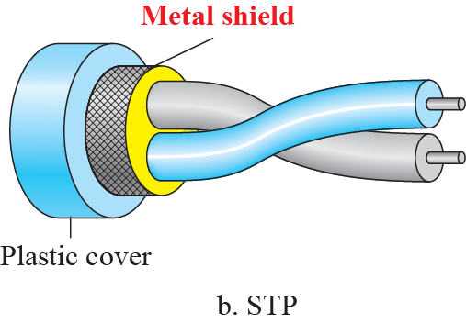
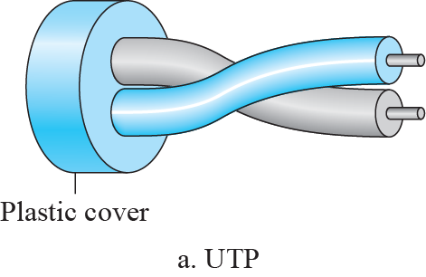

7.2.1 Twisted-Pair Cable
Unshielded and Shielded Twisted-Pair Cable
Twisted-Pair Cable 의 주파수 범위

Slide 9
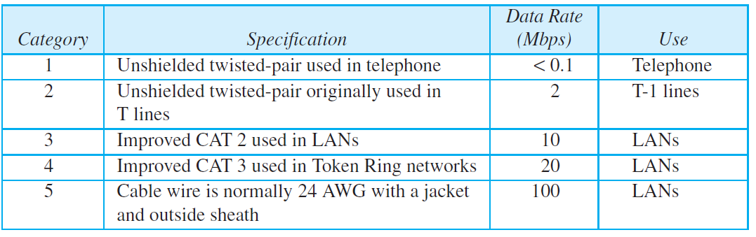
7.2.1 Twisted-Pair Cable
Categories of unshielded twisted-pair cables

Slide 10
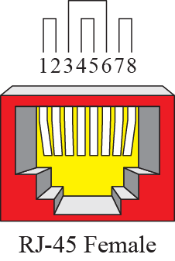
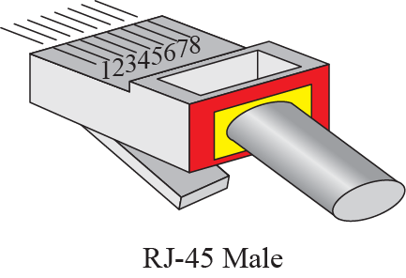
7.2.1 Twisted-Pair Cable
UTP Connectors
Application of UTP
  Telephone lines for voice and data channels
  DSL lines for high data rate connections: 고대역 UTP 사용
  10Base-T and 100Base-T LAN

Slide 11
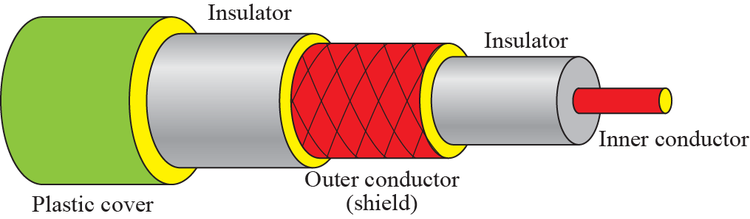
7.2.2 Coaxial Cable
Coaxial cable carries signals of higher frequency ranges than those in twisted pair cable
  Coax has a central core conductor (usually copper).
  Coax is enclosed in an insulating sheath, which is, in turn, encased in an outer conductor.
  The outer metallic wrapping serves both as a shield against noise and as the second conductor, which completes the circuit.

Slide 12
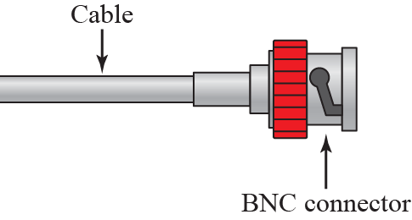
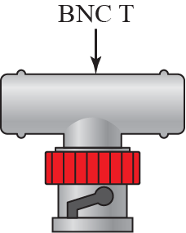
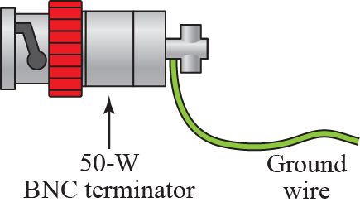
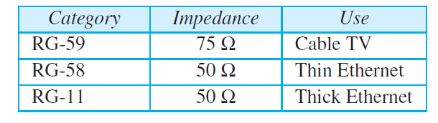
7.2.2 Coaxial Cable
Coaxial Cable Connectors
Coaxial Cable Category

Slide 13
7.2.2 Coaxial Cable
Application of Coaxial Cable
  Analog telephone network : single coaxial network can carry 10,000 voice signals.
  Analog telephone network : can carry digital data upto 600Mbps
  Cable TV
  Ethernet LAN
    10BASE2 : Thin Ethernet, 10Mbps with a range of 185m
    10BASE5 : Thick Ethernet, 10Mbps with a range of 500m

Slide 14
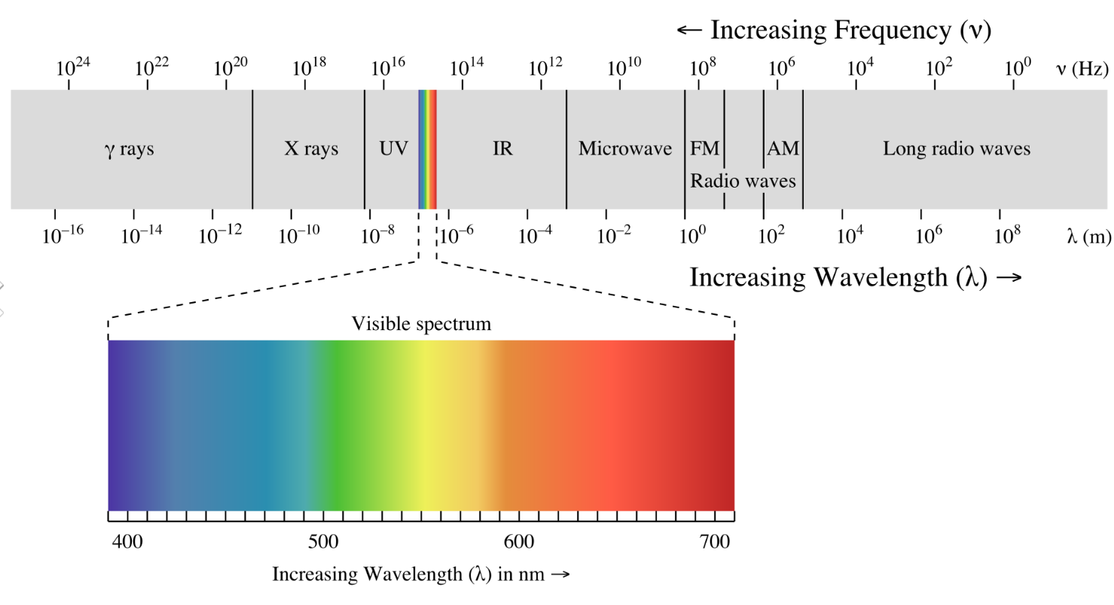
7.2.3 Optical Fiber Cable
Light
  Light is electromagnetic radiation within a certain portion of the electromagnetic spectrum.
  The speed of light in vacuum is approximately 300,000 km/s (186,000 mile/s)

Slide 15
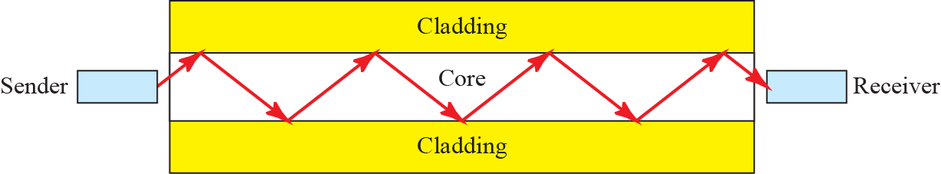
7.2.3 Optical Fiber Cable
A fiber-optic cable is made of glass or plastic and transmits signals in the form of light.
  A glass(or plastic) core is surrounded by a cladding of less dense glass(or plastic).
  Optical fiber use reflection to guide light through a channel.
  A beam of light moving through the core is reflected off the cladding by the difference in density of the two different materials.

Slide 16
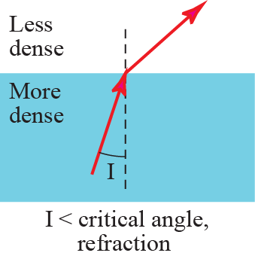
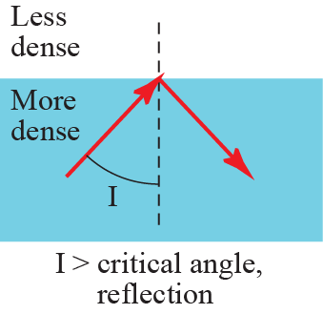
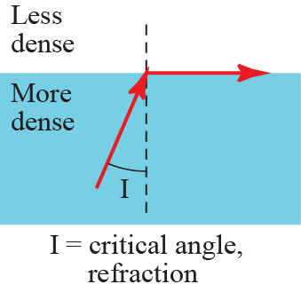
7.2.3 Optical Fiber Cable
How a ray of light changes direction when going from a more dense to a less dense substance?
  Light travels in a straight line as long as it is moving through a single uniform substance.
  If a ray of light traveling through one substance suddenly enters another substance (of a different density), the ray changes direction.

Slide 17
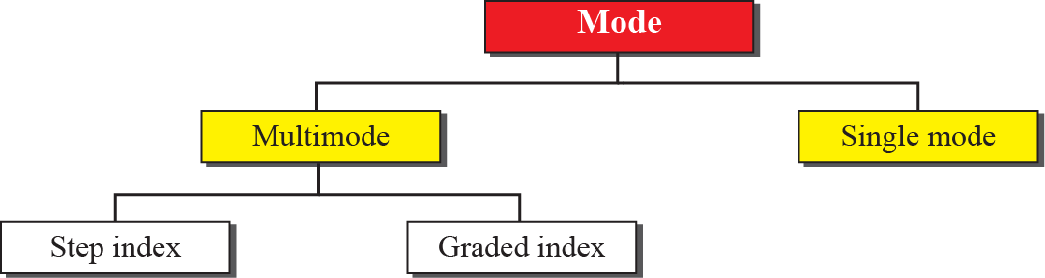
7.2.3 Optical Fiber Cable
Two Propagation Modes
  Multi-mode : multiple beams from a light source
  Single-mode :

Slide 18

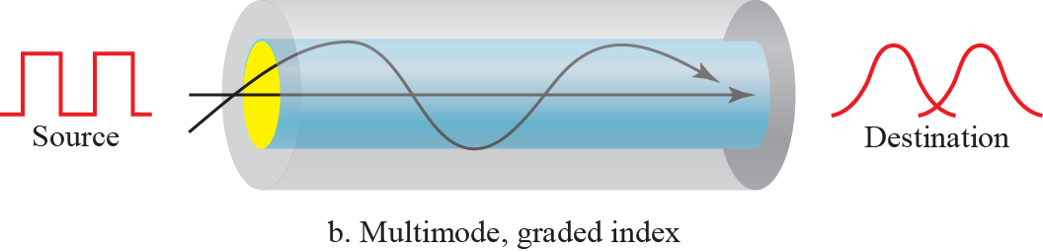
7.2.3 Optical Fiber Cable
Multimode – Step Index Fiber
  The density of the core remains constant.
  It causes the distortion of the signal.
Multimode – Graded Index Fiber
  The density is highest at the center of the core.
  It decreases the distortion of the signal.

Slide 19
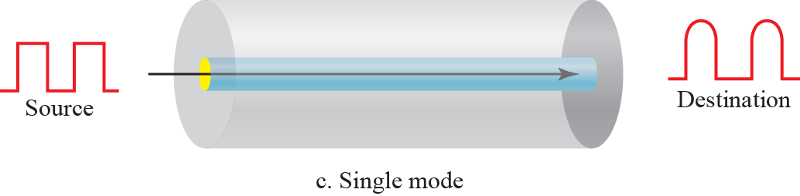
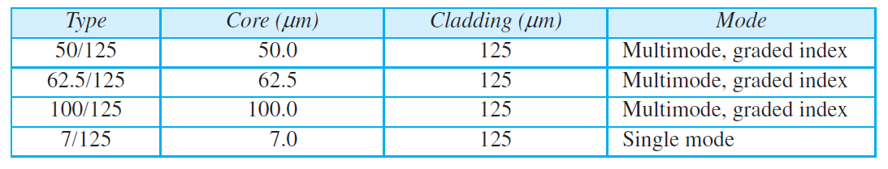
7.2.3 Optical Fiber Cable
Single Mode
  Much smaller diameter (below 10μm) of core, and lower density.
광섬유 유형

Slide 20
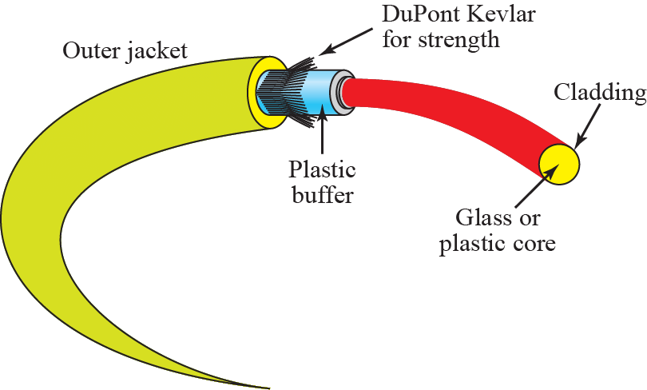
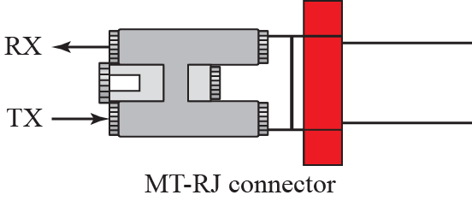
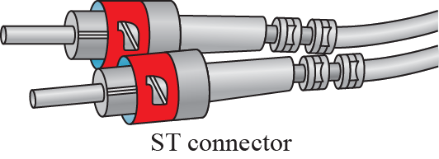
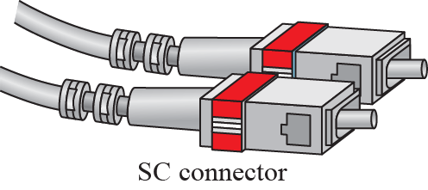
7.2.3 Optical Fiber Cable
Optical Fiber Cable and Connector
  Subscriber Channel Connector
  Straight Tip Connector

Slide 21
7.2.3 Optical Fiber Cable
Advantage of Optical Fiber Cable
  Higher bandwidth
  Less signal attenuation
  Immunity to electromagnetic interference
  Resistance to corrosive materials
  Light weight
  Greater immunity to tapping
Disadvantages of Optical Fiber Cable
  Installation and maintenance
  Unidirectional light propagation
  Cost

Slide 22
7.3 Unguided Media : Wireless
Unguided medium transport waves without using a physical conductor.
  This type of communication is often referred to as wireless communication.
Signals are normally broadcast through free space and thus are available to anyone who has a device capable of receiving them.
Topics discussed in this section:
7.3.1 Radio Waves
7.3.2 Microwaves
7.3.3 Infrared

Slide 23

7.3 Unguided Media
Categories of Wireless Transmission

Slide 24

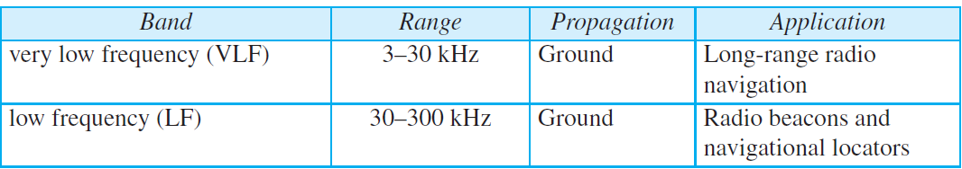
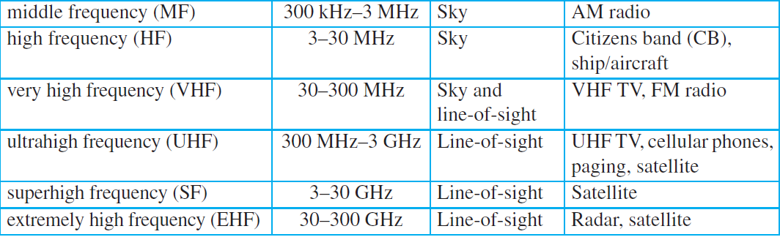
7.3 Unguided Media
Electromagnetic spectrum for wireless

Slide 25

7.3 Unguided Media
Propagation methods
  Ground Propagation
    Radio waves travel through the lowest portion of the atmosphere.
  Sky Propagation
    Higher frequency of radio waves radiate upward into the ionosphere.
    Greater distance with lower output power
  Line-of-Sight Propagation
    Very High frequency signals are transmitted in straight lines directly from antenna to antenna.

Slide 26
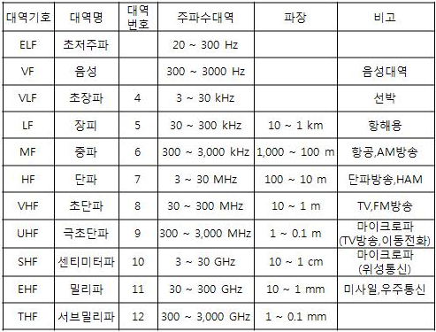
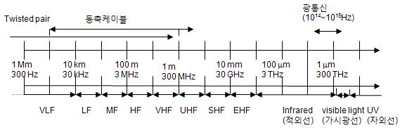
7.3 Unguided Media
대역
1GHz의 공기 중 파장은 30cm이다.
10GHz의 파장은 3cm. 30GHz의 파장은 1cm.
30GHz 이상이 되면 파장이 mm단위가 된다.

Slide 27

7.3.1 Radio Wave
Classification of Radio Wave
  Radio waves : ranging between 3kHz ~ 1GHz
  Microwaves : ranging between 1GHz ~ 300GHz
Radio Waves
  Radio waves are omnidirectional propagated in all direction.
  Sending and receiving antennas do not have to be aligned.
Radio waves are used for multicast communications, such as radio and television, and paging systems.

Slide 28
7.3.2 Microwave
Microwaves
  Microwaves have the frequency of 1~300GHz, and unidirectional.
  The sending and receiving antennas need to be aligned without interfering with another pair of aligned antennas.
    Propagation is line-of-sight (Antena-to-Antena)
    It cannot penetrate walls
Microwaves are used for unicast communication such as cellular telephones, satellite networks, and wireless LANs.

Slide 29
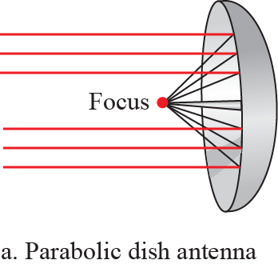
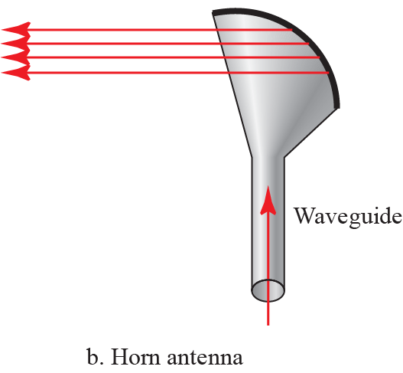
7.3.2 Microwave
Unidirectional antenna
The behavior of the waves is a better criterion for classification.

Slide 30
7.3.3 Infrared Wave
Infrared waves can be used for short-range communication.
  Frequencies : 300GHz ~ 400THz (Wavelengths : 1mm ~ 770nm)
  Wide Bandwidth, Data rate of 4Mbps for a distance up to 8m.
  IrDA port allows a wireless keyboard, mouse, and printer to communicate with PC.
Infrared waves cannot penetrate walls.
  It prevents interference between one system and another.
  Infrared remote controller does not interfere with the use of the remote by our neighbors.
Infrared signals can be used for short-range communication in a closed area using line-of-sight propagation.

Slide 31

7.4 Summary
Transmission Media

